Slide 1



FOOD DESERTS BY ZIPCODE
INTRODUCTION/PROBLEM
How Big is the Problem in Three Largest U.S. Cities?
Los Angeles
Chicago
New York
(Cont’d on next page)

Slide 2

Introduction/Business Problem
Healthful diets have a significant positive effect on reducing the occurrence of heart disease, diabetes, and even cancer. Yet, healthful diets are dependent on access to healthy food, which is generally available in supermarkets and generally not available in alternative stores like convenient stores. If the grocery stores are too few and far between, something we call a food desert, the purchase of healthy diet food is confounded.
The food desert concept was first discussed in the 1990s. The metaphor is built on a desert paradigm. The wandering person is in the desert and looking for water at an oasis. If the person cannot find the desert, the person’s chance of survival are limited.
In the food desert, the wandering person is in the neighborhood (the desert) looking for healthy food at a supermarket (the oasis). If the person cannot find the supermarket, his alternatives for healthy food purchases and therefore consumption are limited.
Research has shown that when food deserts are found, either convenient stores or fast food chains will provide nutritional support, both of which marginalize nutrition consumptions.
(Cont’d on next page)

Slide 3
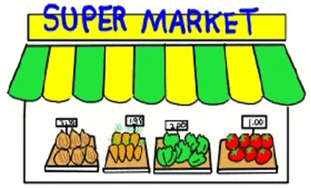
Introduction/Business Problem (cont’d)
The purpose of this research is to determine if a simple zip code analysis using Foursquare information can describe this situation in three large cities in the United States – Los Angeles, Chicago, and New York. Unlike other research, this is a comparative study looking to compare high income store count with low income store count to gauge the disparity rather than determining an arbitrary value for the food desert definition.
If the analysis shows food deserts still exist in significant areas, then city, municipal, county, state, and federal agencies can use this information to set policy. These policies could be transportation based - to improve access to further stores, incentive based – incenting new store construction, or even price based – promoting better for you foods when additional stores are not possible.

